Slide 1
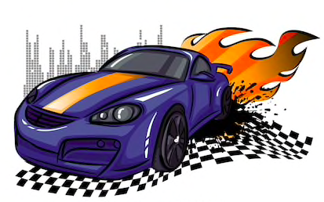
GEARS
Speeeeeeed it up….........

Slide 2
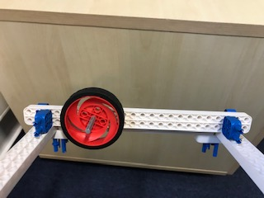
The wheel moves on its own.

Slide 3
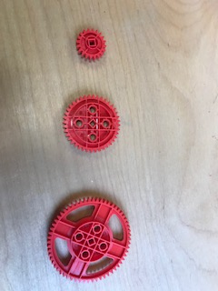
Three gear sizes
60 teeth
40 teeth
20 teeth

Slide 4
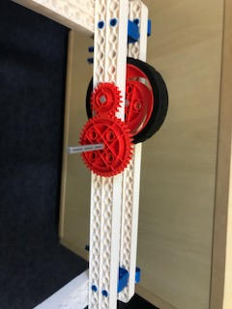
The wheel moves along with the small gear. The 40-teeth-gear doubles the speed of the 20-teeth-gear.
2 x v

Slide 5
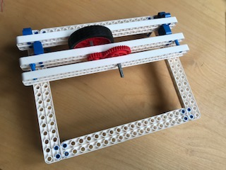
Now Let’s drive even faster!

Slide 6
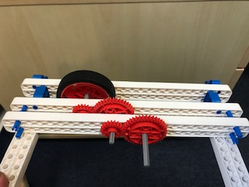
The second gear-train makes the wheel run 4 times faster.
4 x v

